Slide 1
Agentic AI Enablement –
AI Practitioner
Sankareswari Athiappan
15 June 2025
Notes:
28

Slide 2
Role-Based AI Prompt Testing
Use Case
Smart Home Automation Platforms: Software to control lighting, temperature, security, and appliances in residential properties.
Test GPT-4, Claude, and Gemini for the above use cases applying all prompting best practices: QA: Test case generation, requirement analysis, bug reproduction Product Owners: User story creation, feature prioritization, market analysis Project Managers: Risk assessment, timeline planning, resource allocation Successfully interact with 3 different AI models and submit the 3 best prompts, justifying their suitability.

Slide 3
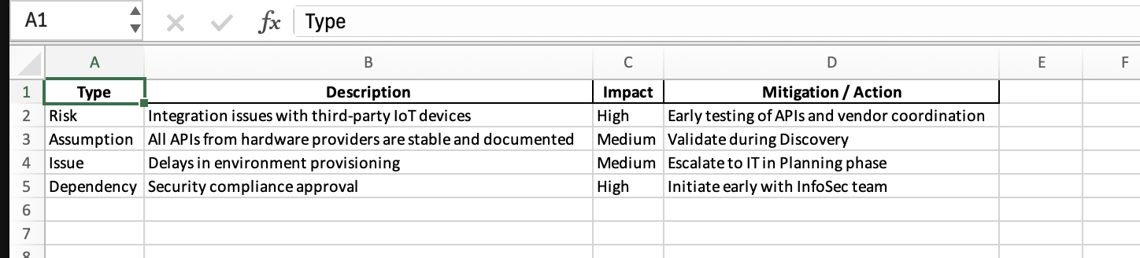
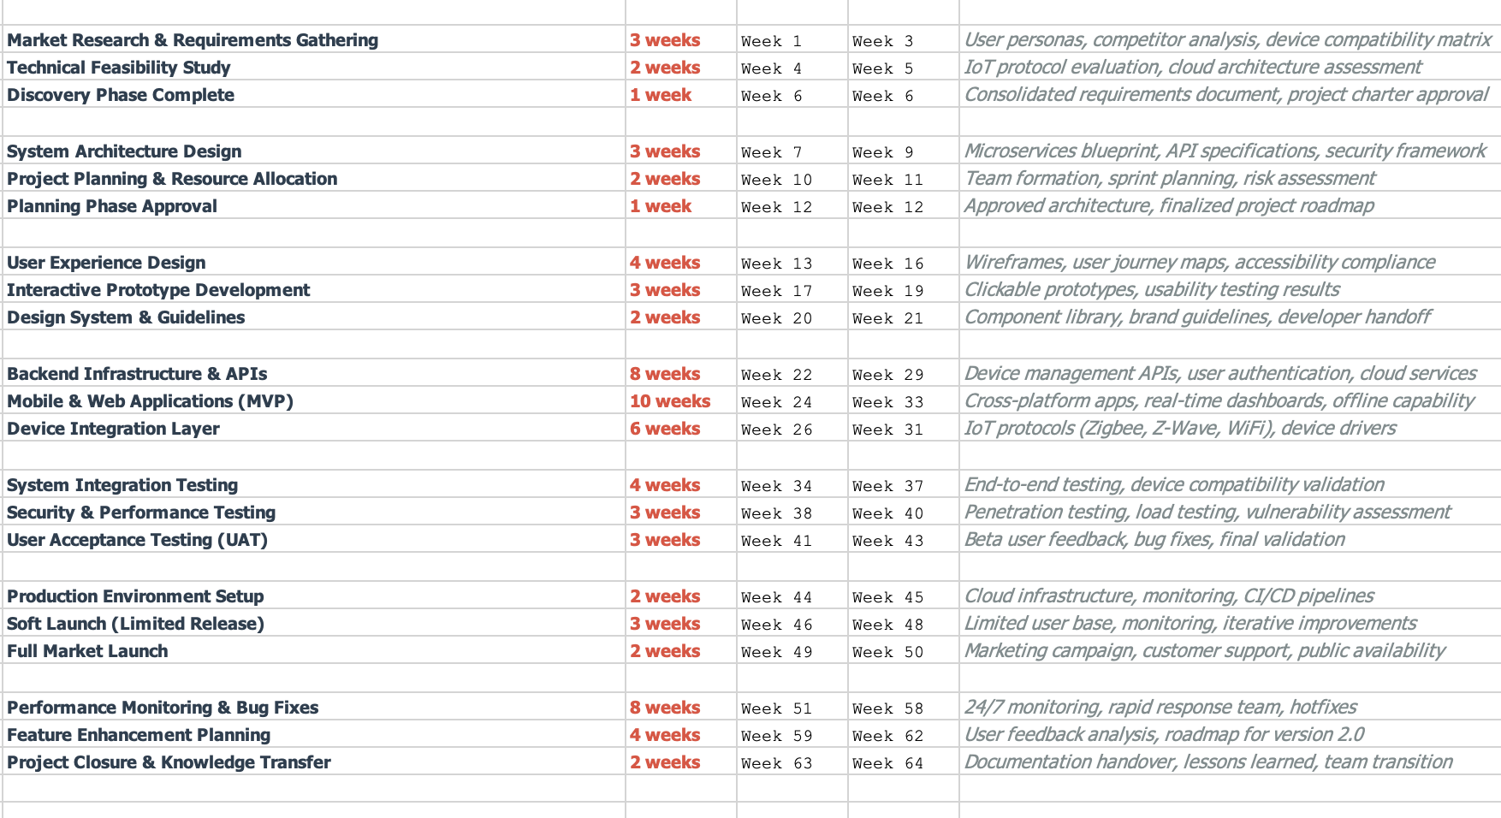
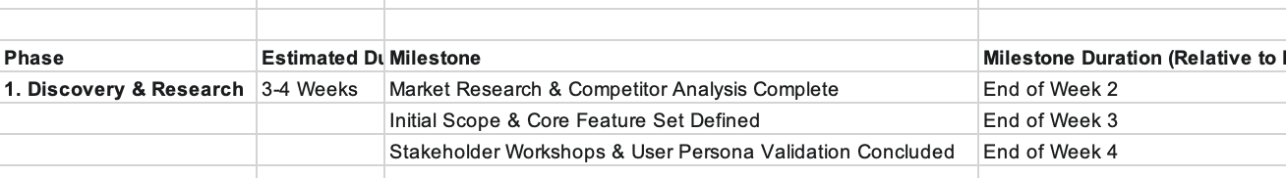
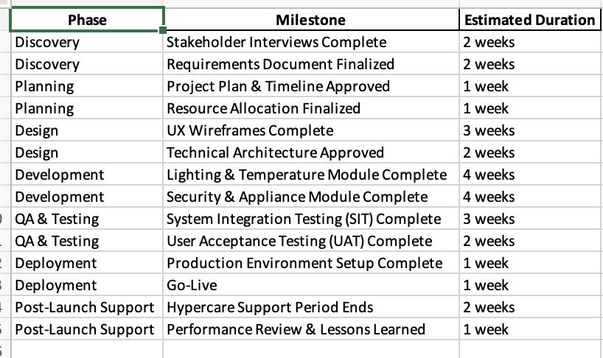
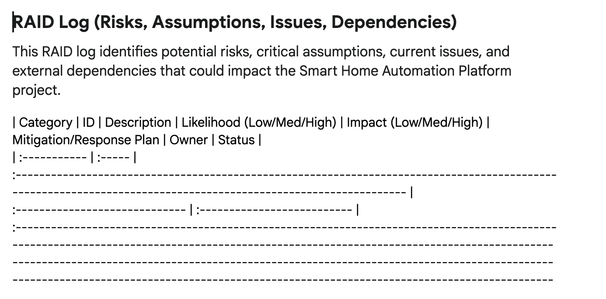
Prompt 1
As a project manager for the given use case Smart Home Automation Platforms: Software to control lighting, temperature, security, and appliances in residential properties, need to create a high Level Timeline Planning (Key Phases/Milestones): Develop a high-level project timeline outline in an excel. Break down the project into logical phases (e.g., Discovery, Planning, Design, Development, QA & Testing, Deployment, Post-Launch Support). For each phase, list 2-3 major milestones and their estimated durations (e.g., 'Discovery Complete - 2 weeks', 'Alpha Release - Month 3'). Focus on a realistic project lifecycle for a complex software platform including Resource allocation ( considering all are FTE 100% allocated) and also provide RAID Log with anticipated Risk assessment and assumptions
This prompts gives the best results in Test GPT-4 compared to Claude & Gemini, the outcome is realistic and ease to use. The understanding of RAID & Project milestones are much better, and response time is quick with GPT-4
GPT-4
Claude
Gemini

Slide 4
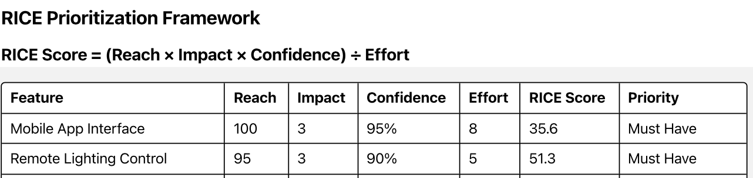
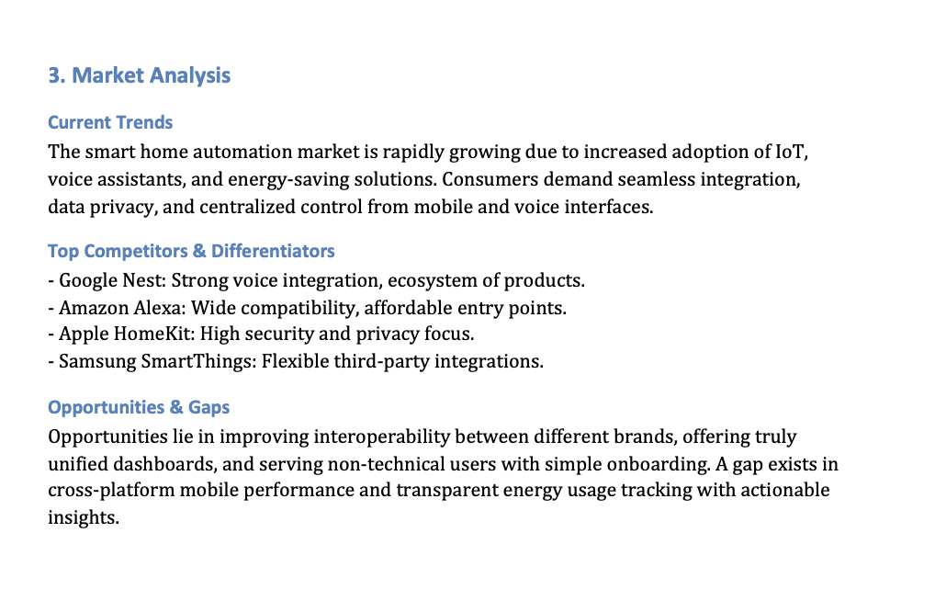
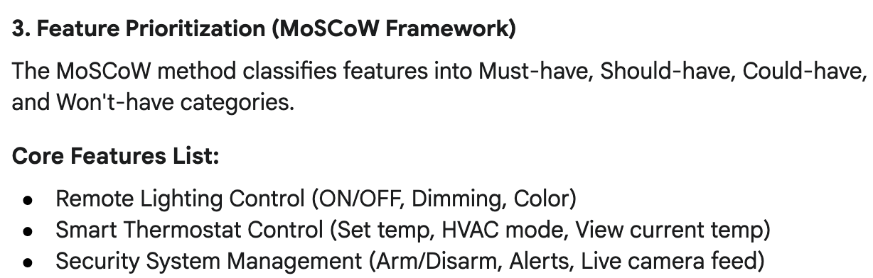
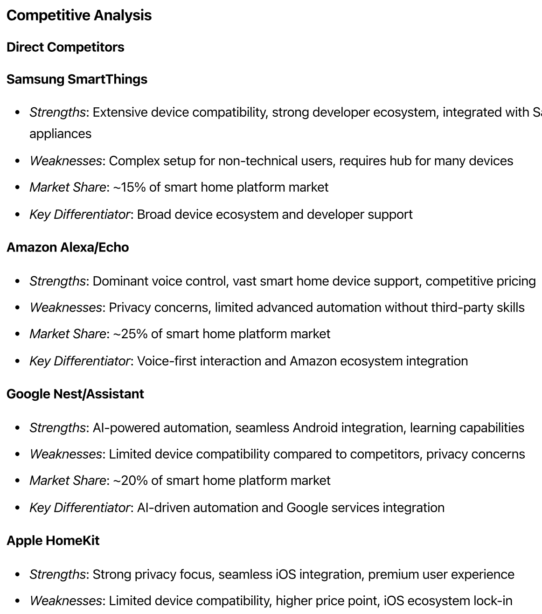
Prompt 2
As the Product Owner for a Smart Home Automation Platform—a software solution designed to control lighting, temperature, security, and appliances in residential properties—create a comprehensive product planning document that includes the following: User Story Creation; Define key user personas (e.g., homeowner, guest, technician). Write 5–7 user stories per persona using the format: “As a [persona], I want to [goal] so that [benefit].”
Feature Prioritization List core features (e.g., remote lighting control, smart thermostat, security alerts, appliance scheduling).
Use a prioritization framework (e.g., MoSCoW, RICE, or Value vs. Effort matrix) to rank features. Market Analysis Summarize current market trends in smart home automation. Identify top competitors and their key differentiators. Highlight opportunities and gaps in the market that your platform can address. The final document should be structured, actionable, and aligned with agile product development practices.
This prompts gives the best results in Claude compared to GPT-4 & Gemini, the outcome is detailed enough as requested and coverage is to the maximum as per request . Market Analysis & Feature prioritization is excellent in Claude
Claude
GPT-4
Gemini

Slide 5
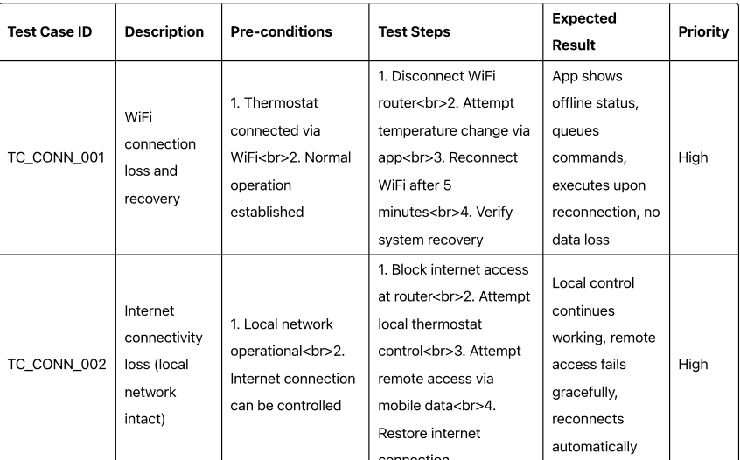
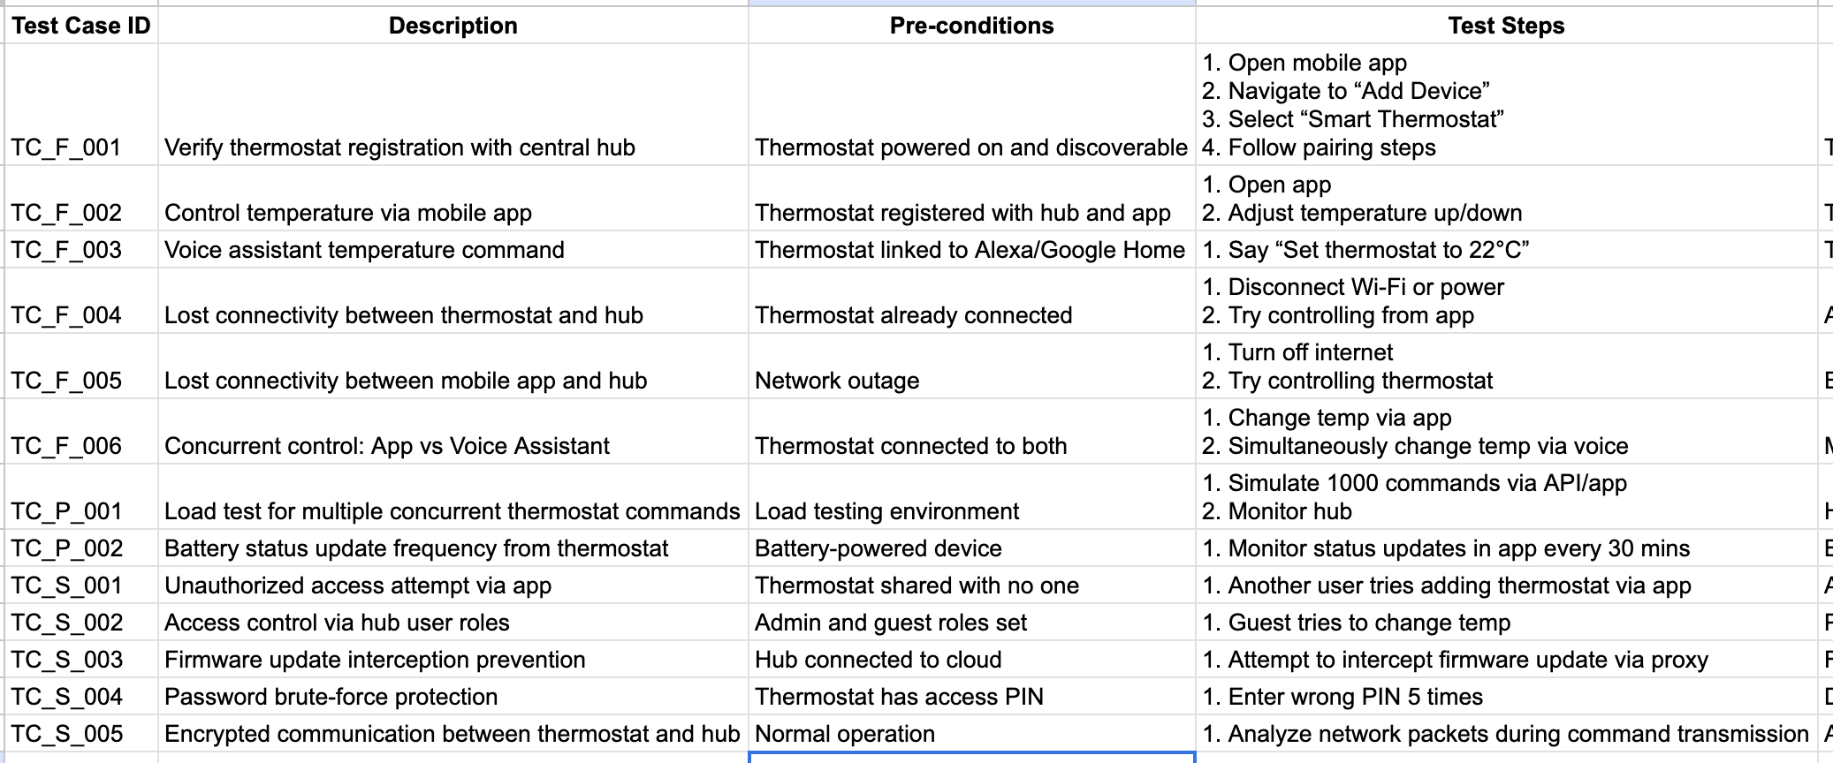
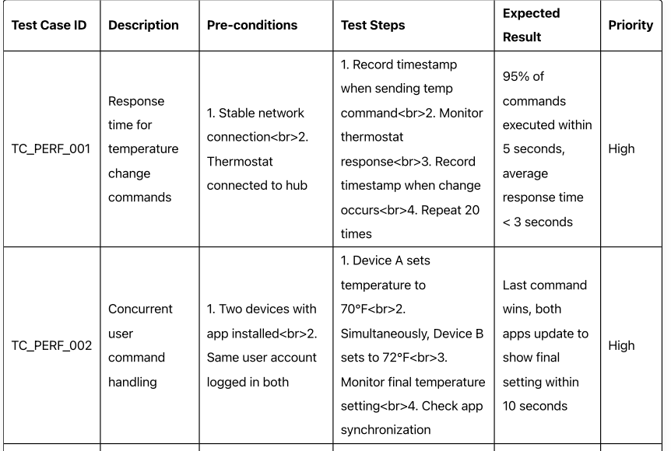
Prompt 3
As a QA Engineer testing a Smart Home Automation Platform, generate a comprehensive set of functional, performance, and security test cases for the integration of a smart thermostat with the central hub and mobile application. Include scenarios for lost connectivity, concurrent user commands (e.g., app vs. voice assistant), and unauthorized access attempts. Provide output in a table format with columns: Test Case ID, Description, Pre-conditions, Test Steps, Expected Result, and Priority." along with Traceability Matrix for requirement mapping eg. Test case id to Use case id mapping and also create a Bug tracking excel with test case id mapped
This prompts gives the best results in Claude compared to GPT-4 & Gemini, the outcome covers all niche cases in performance and security testing; additionally, it provides network test cases as well
Claude
GPT-4
Gemini
ONLY 7 TEST CASES ARE PROVIDED, FUNCTIONAL TESTING IS NOT EXTENSIVEY COVERED

Slide 6

Thank You

